Slide 1
PiXL Maths App
Matt Woodfine
Lead Practitioner at Hinchingbrooke School

Slide 2
What is the PMA?

Slide 3
The PiXL Maths App is a resource that puts the power of PiXL in the hands of the people that can make a difference...YOU!

Slide 4
The app is a diagnostic tool that enables you to identify strengths and areas to develop within the Mathematics curriculum. From this information the app can suggest a plan that will target the areas in need of development with the support of video tutorials, notes and key feedback from staff.

Slide 5
The app also contains an innovative QLA system that collates information about your performance in a written paper. It can then use the information to help build work profiles on how to improve, workbooks, and feed forward tasks.

Slide 6
One of the strongest aspects of the app is the ability to promote engagement. The integrated league table enables you to quickly monitor your use of the app against your classmates to ensure that are putting in as much effort as they are.

Slide 7
How do I get it?

Slide 8

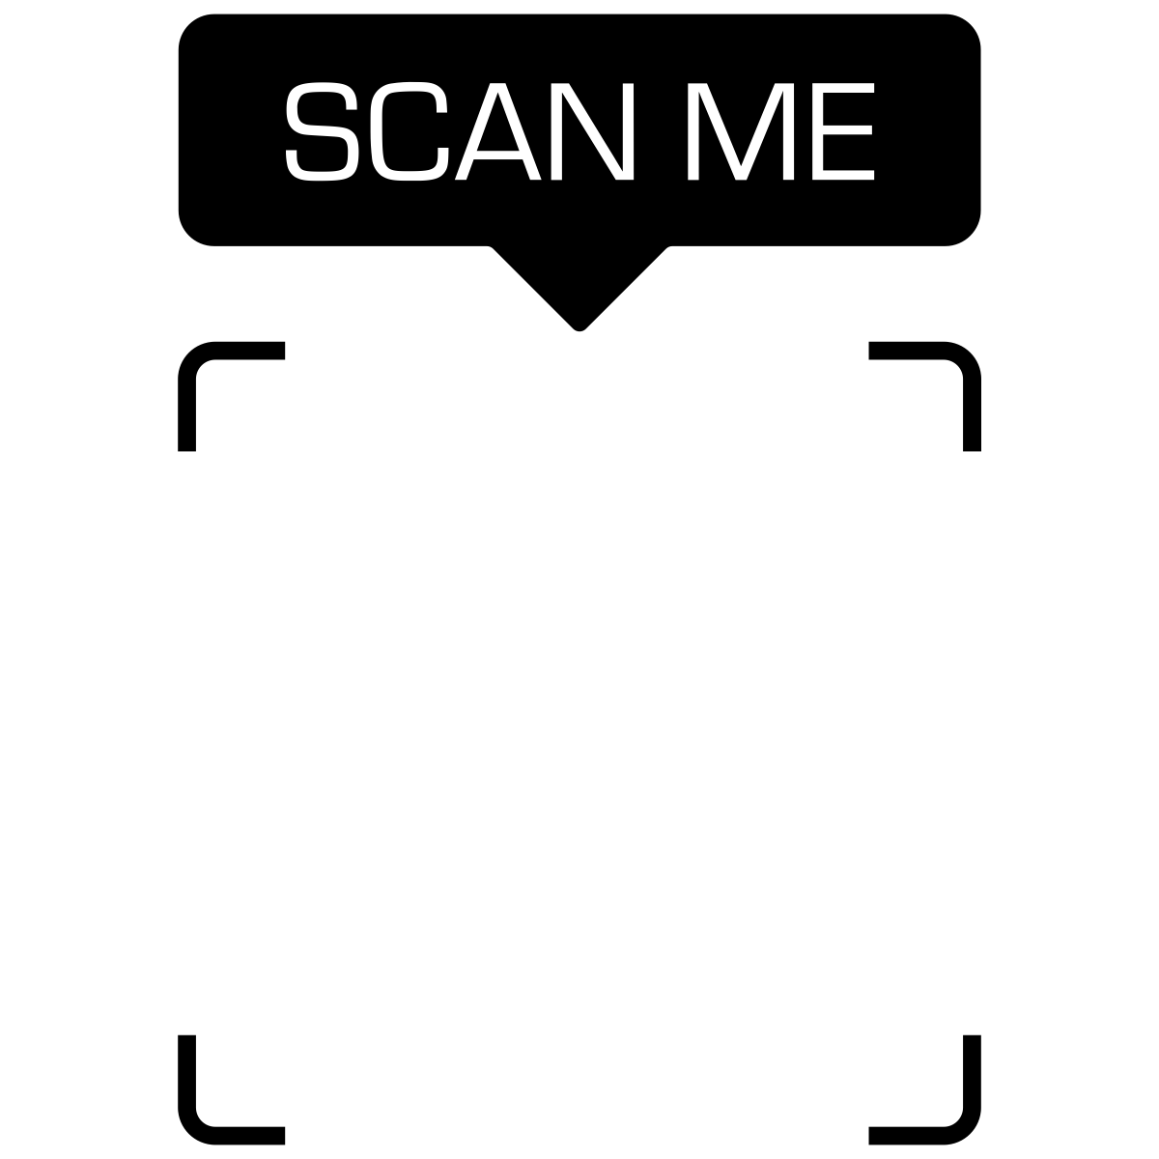
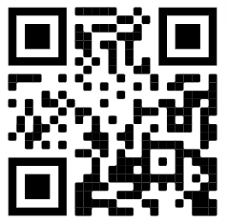
Head to
https://mathsapp.pixl.org.uk
OR
With your device’s camera

Slide 9
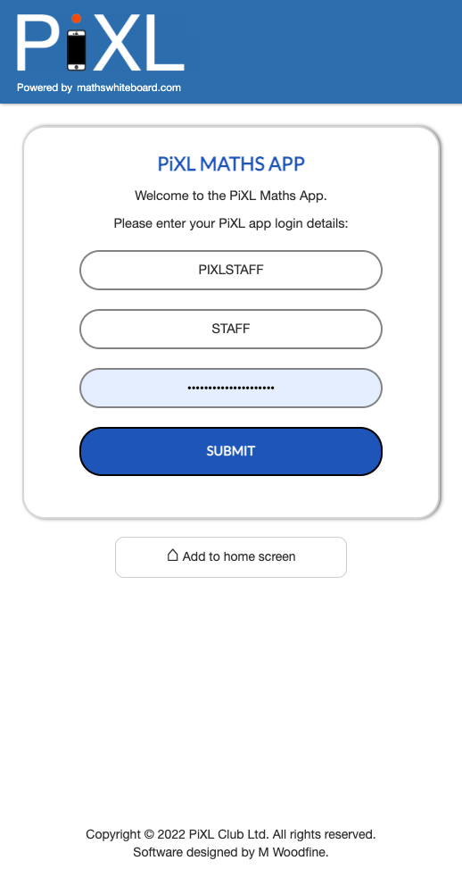
Sign in

Slide 10
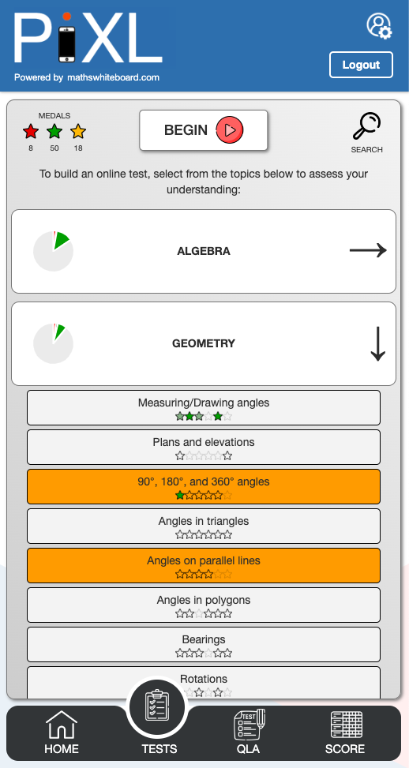
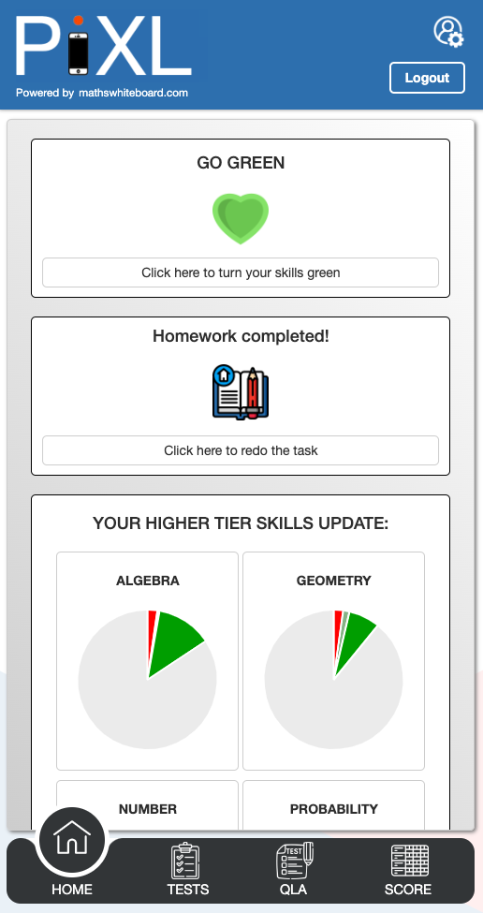
This is your home screen where you will be able to find any set tasks and an overview of your performance.
Select ”Tests”.
Choose a few topics from the available options and select “Begin” at the top.

Slide 11
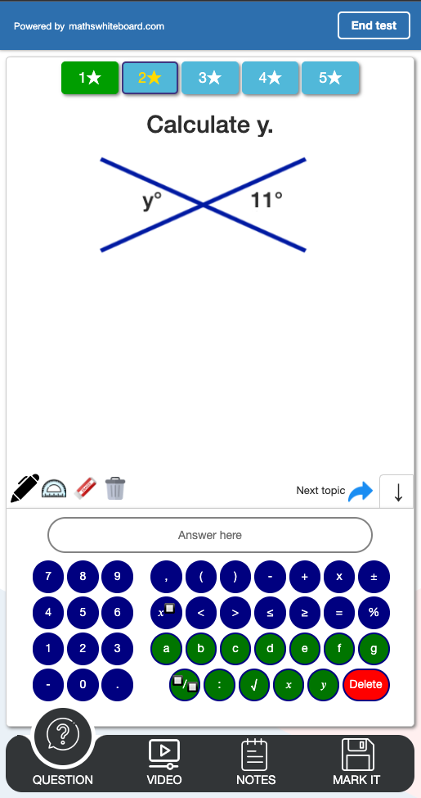
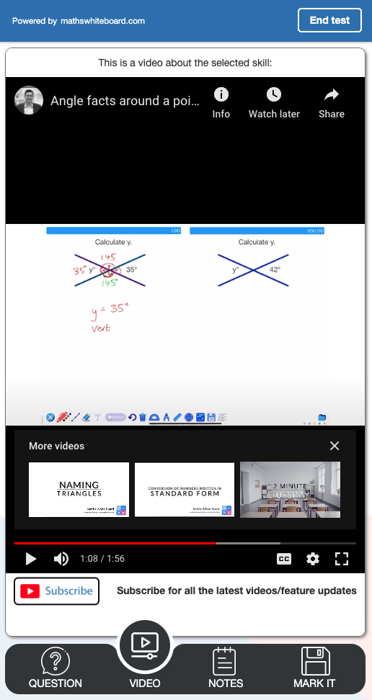
Use the key pad (or your key board) to complete the questions.
If you are stuck, use the videos or notes to help you.
Press “Mark it”. Learn from the answer. Choose another difficulty using the stars at the top or skip the topic.

Slide 12
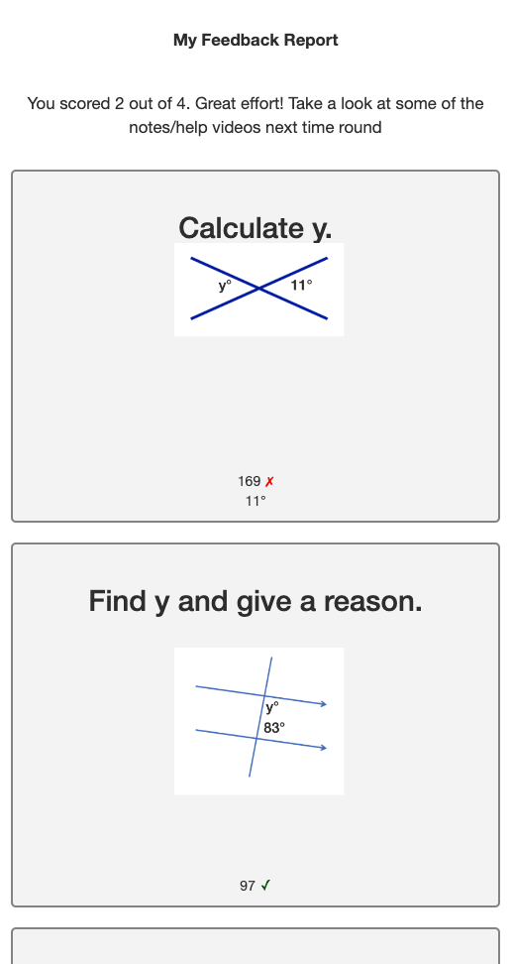
Learn from your feedback at the end of the assessment and then return back to the main menu.

Slide 13
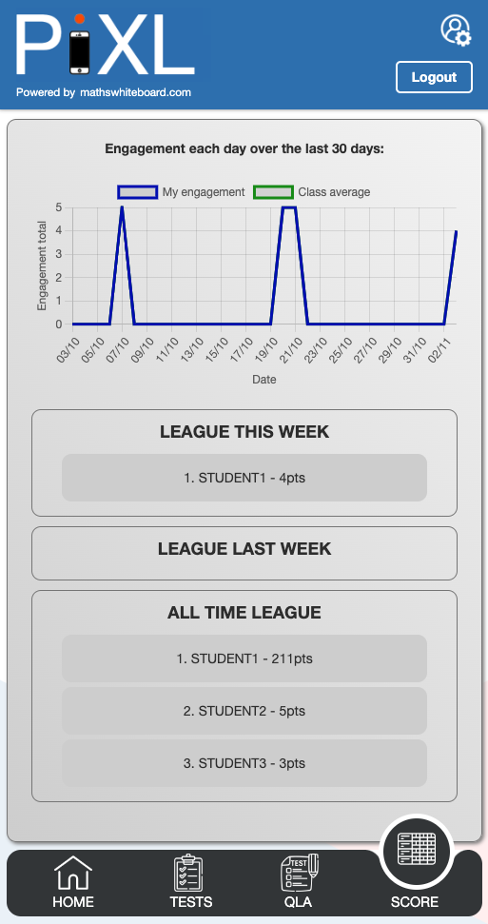
Select “Score”.
How does your engagement with the app compare with others in your class?

Slide 14
PiXL Maths App
Head to https://mathsapp.pixl.org.uk
Can you turn 10 skill based questions green? How many of you will be able to collect the golden stars by turning all star difficulties green for a specific topic?
If you have any feedback, please contact your teacher.

